Slide 1
Application of Contraction Mapping Theorem
By Shuowen Wei
May 3, 2012

Slide 2
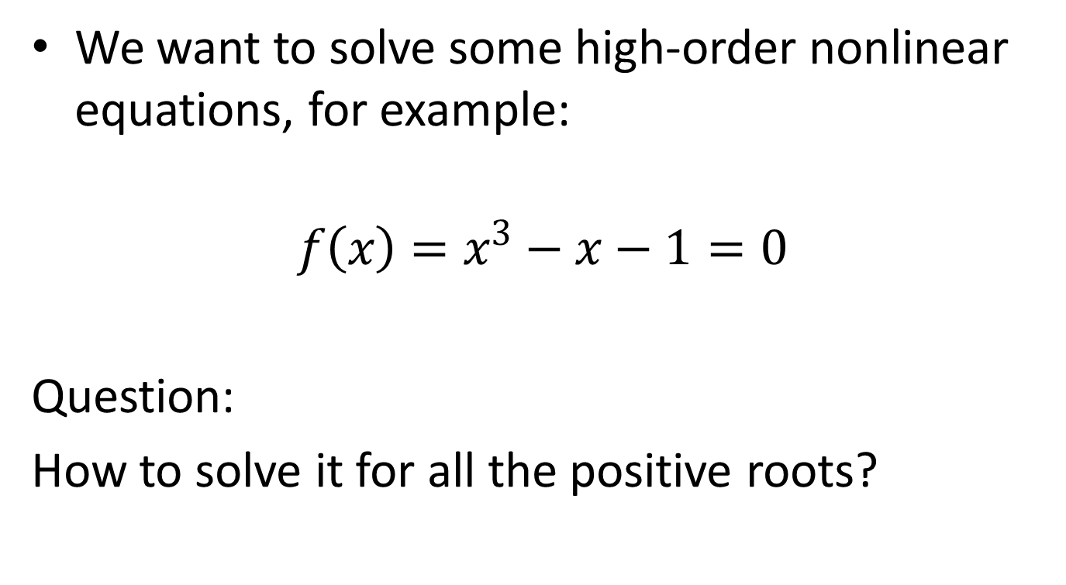
Introduction
We want to solve some high-order nonlinear equations, for example:
$$f\left(x\right)=x^{3}−x−1=0$$
Question:
How to solve it for all the positive roots?

Slide 3
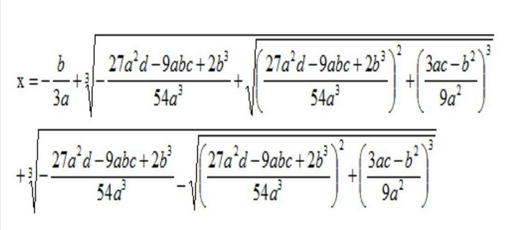
Of course, we know there exists some formula to solve such cubic equation:
By Gerolamo Cardano (1501 – 1576)

Slide 4
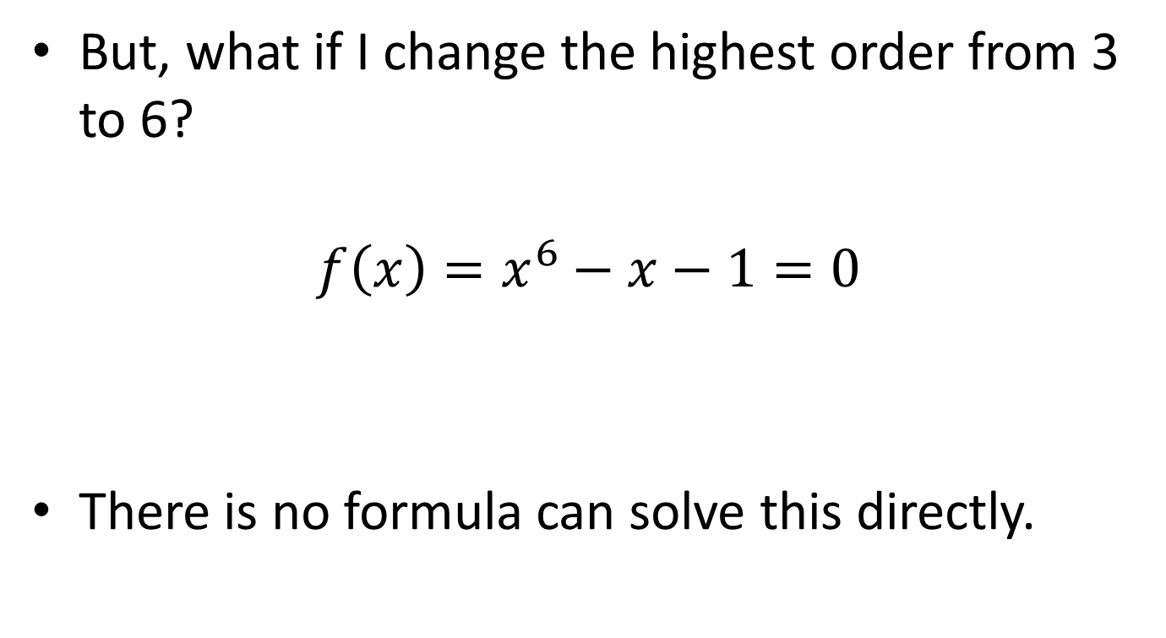
But, what if I change the highest order from 3 to 6?
$$f\left(x\right)=x^{6}−x−1=0$$
There is no formula can solve this directly.

Slide 5
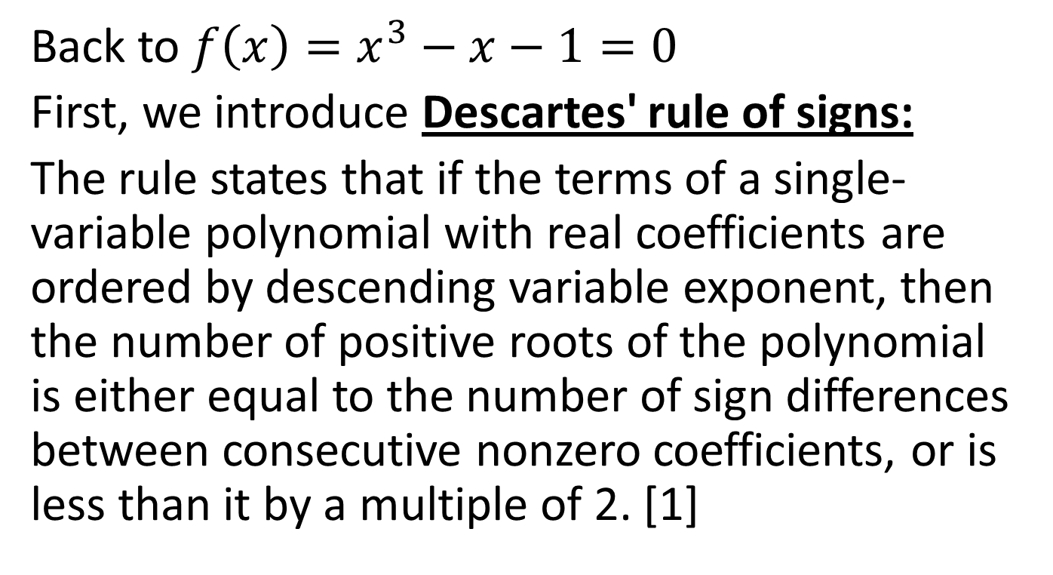
Back to $f\left(x\right)=x^{3}−x−1=0$
First, we introduce Descartes' rule of signs:
The rule states that if the terms of a single-variable polynomial with real coefficients are ordered by descending variable exponent, then the number of positive roots of the polynomial is either equal to the number of sign differences between consecutive nonzero coefficients, or is less than it by a multiple of 2. [1]

Slide 6
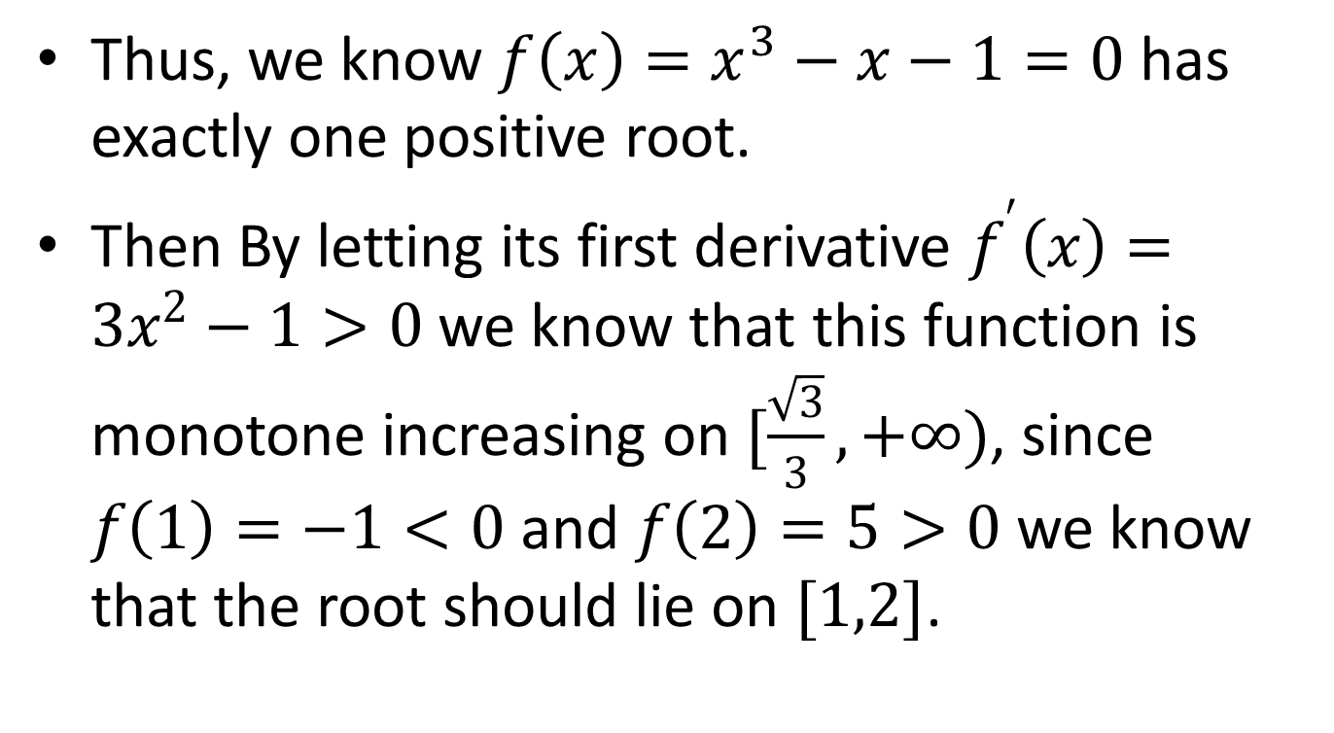
Thus, we know $f\left(x\right)=x^{3}−x−1=0$ has exactly one positive root.
Then By letting its first derivative $f^{′}\left(x\right)=3x^{2}−1>0$ we know that this function is monotone increasing on$[\frac{\sqrt{3}}{3},+∞)$, since $f\left(1\right)=−1<0$ and $f\left(2\right)=5>0$ we know that the root should lie on $[1,2]$.

Slide 7
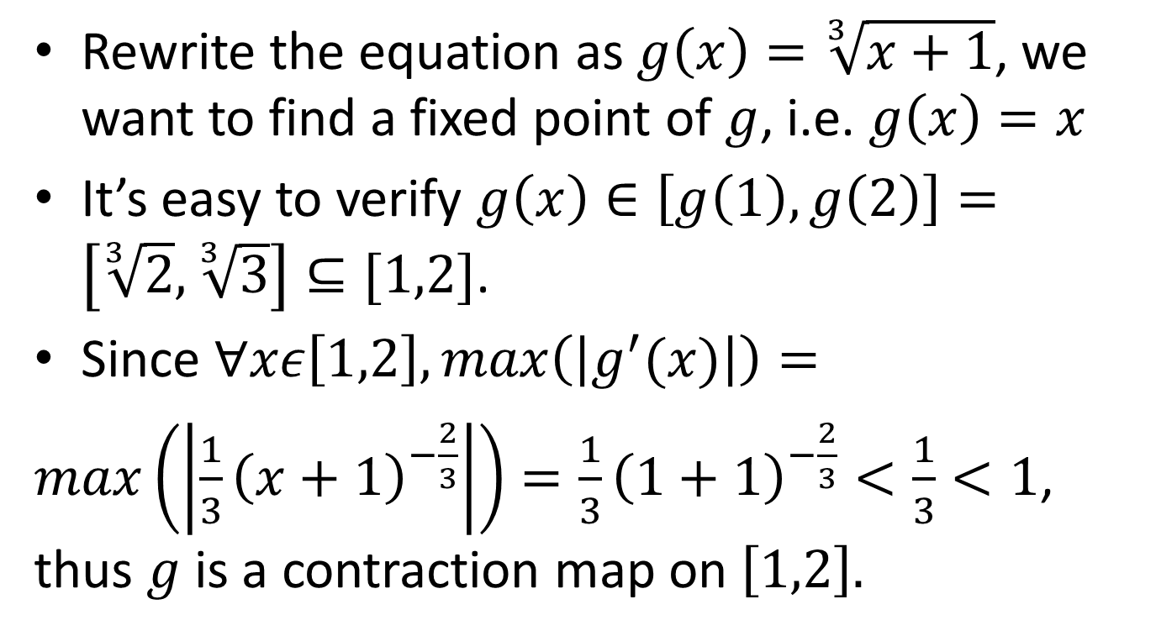
Rewrite the equation as $g\left(x\right)=\sqrt[3]{x+1}$, we want to find a fixed point of $g$, i.e. $g\left(x\right)=x$
It’s easy to verify $g\left(x\right)∈\left[g\left(1\right),g\left(2\right)\right]=\left[\sqrt[3]{2},\sqrt[3]{3}\right]⊆[1,2]$.
Since $∀xε\left[1,2\right],max\left(\left|g^{′}(x)\right|\right)=$
$max\left(\left|\frac{1}{3}{\left(x+1\right)}^{−\frac{2}{3}}\right|\right)=\frac{1}{3}{\left(1+1\right)}^{−\frac{2}{3}}<\frac{1}{3}<1$, thus $g$ is a contraction map on $\left[1,2\right].$

Slide 8
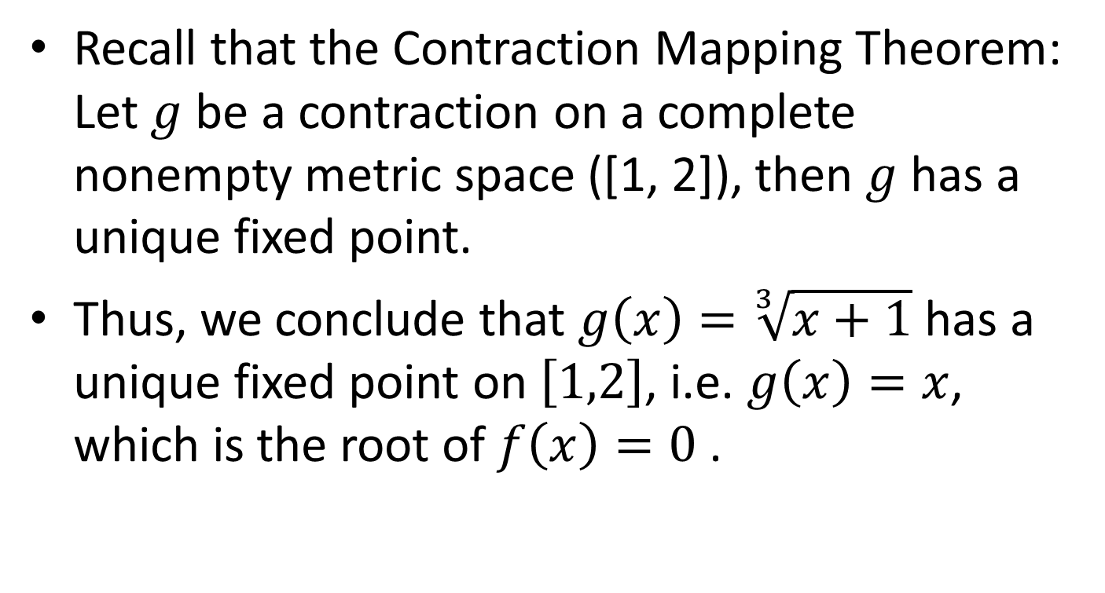
Recall that the Contraction Mapping Theorem: Let $g$ be a contraction on a complete nonempty metric space ([1, 2]), then $g$ has a unique fixed point.
Thus, we conclude that $g\left(x\right)=\sqrt[3]{x+1}$ has a unique fixed point on $\left[1,2\right]$, i.e. $g\left(x\right)=x$, which is the root of $f\left(x\right)=0$.

Slide 9
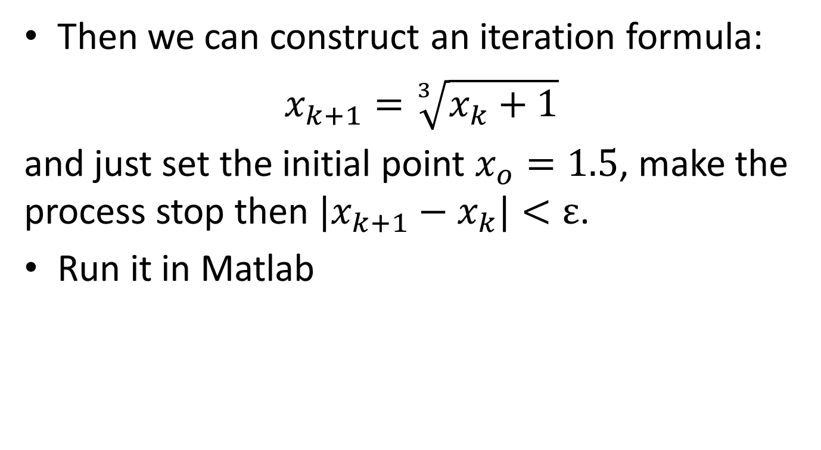
Then we can construct an iteration formula:
$x_{k+1}=\sqrt[3]{x_{k}+1}$
and just set the initial point $x_{o}=1.5$, make the process stop then ${|x}_{k+1}−x_{k}|<ε$.
Run it in Matlab

Slide 10
Matlab Codes
clc;clear
format compact
X=[];
x(1)=1.5;
x(2)=(x(1)+1)^(1/3);
i=1;
epsilon=0.00001;
while(norm(x(i+1)-x(i))>epsilon)
i=i+1;
x(i+1)=(x(i)+1)^(1/3);
end
step=i
x

Slide 11
Matlab Outputs
step =
7
x =
1.5000 1.3572 1.3309 1.3259 1.3249 1.3248 1.3247 1.3247

Slide 12
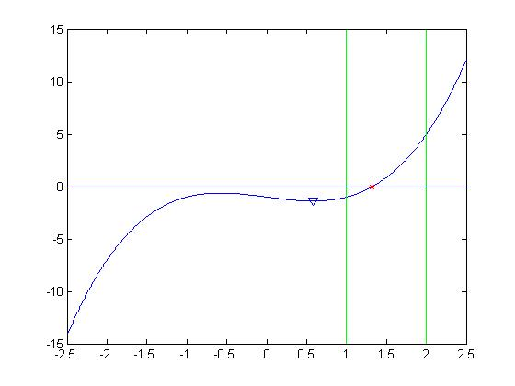
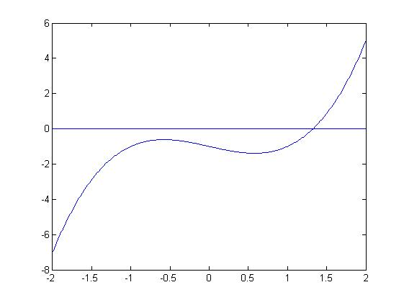
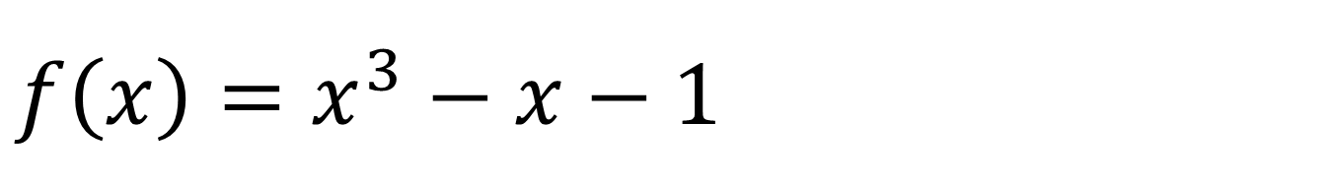
$$f\left(x\right)=x^{3}−x−1$$

Slide 13
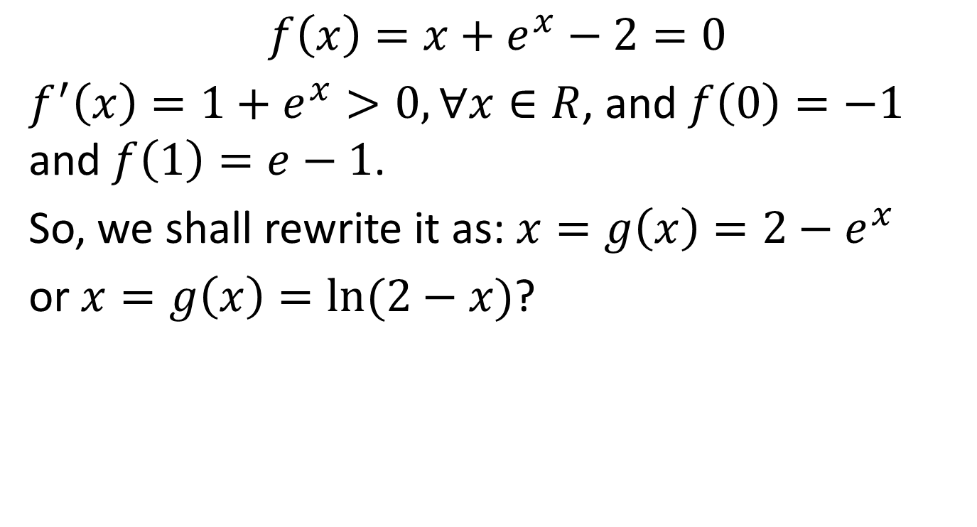
Another Example
$f\left(x\right)=x+e^{x}−2=0$
$f^{′}\left(x\right)=1+e^{x}>0, ∀x∈R$, and $f\left(0\right)=−1$ and $f\left(1\right)=e−1$.
So, we shall rewrite it as: $x=g\left(x\right)=2−e^{x}$
or $x=g\left(x\right)=ln⁡(2−x)$?

Slide 14
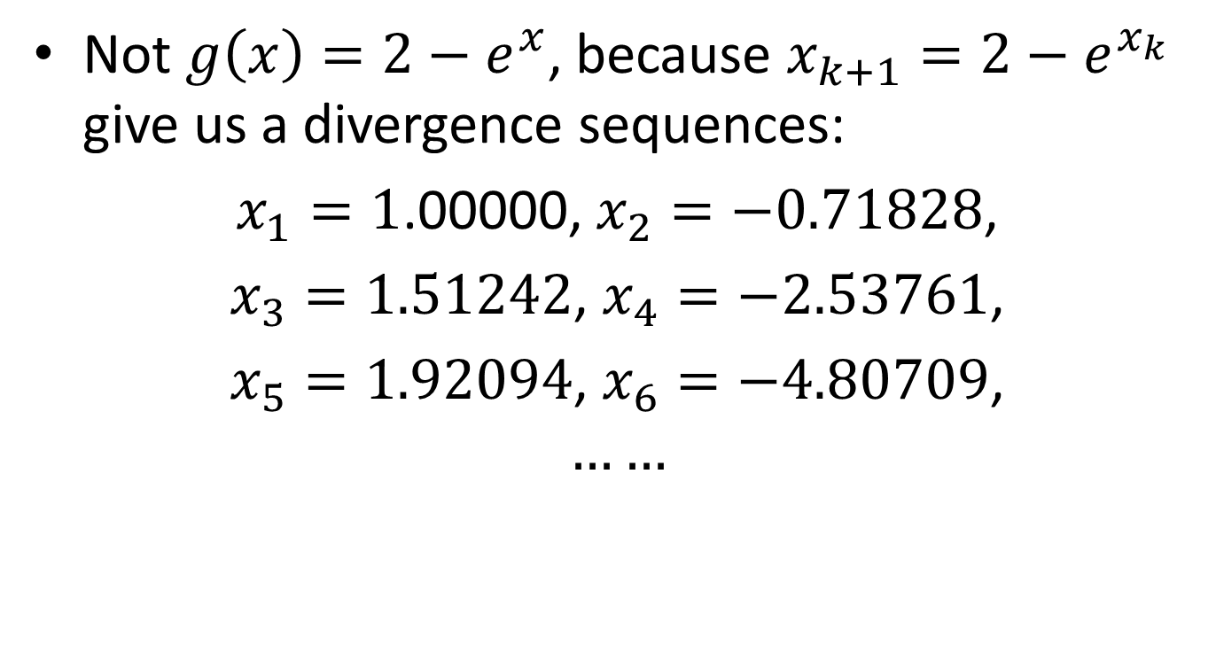
Not $g\left(x\right)=2−e^{x}$, because $x_{k+1}=2−e^{x_{k}}$ give us a divergence sequences:
$x_{1}=1$.00000, $x_{2}=−0.71828$,
$x_{3}=1.51242$, $x_{4}=−2.53761$,
$x_{5}=1.92094$, $x_{6}=−4.80709$,
$$……$$

Slide 15
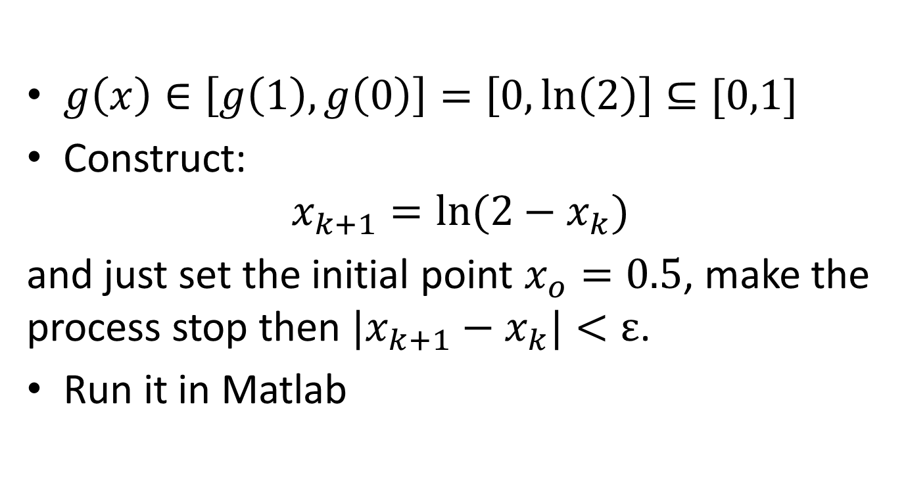

Choose $g\left(x\right)=ln⁡(2−x)$
$g\left(x\right)∈\left[g\left(1\right),g\left(0\right)\right]=\left[0,\ln\left(2\right)\right]⊆[0,1]$
Construct:
$$x_{k+1}=ln⁡({2−x}_{k})$$
and just set the initial point $x_{o}=0.5$, make the process stop then ${|x}_{k+1}−x_{k}|<ε$.
Run it in Matlab

Slide 16
Matlab Codes
clc;clear
format compact
X=[];
x(1)=0.5;
x(2)=log(2-x(1));
i=1;
epsilon=0.00001;
while(norm(x(i+1)-x(i))>epsilon)
i=i+1;
x(i+1)=log(2-x(i));
end
step=i
x

Slide 17
Matlab Outputs
step =
22
x =
Columns 1 through 8
0.5000 0.4055 0.4666 0.4275 0.4527 0.4365 0.4469 0.4402
Columns 9 through 16
0.4445 0.4418 0.4435 0.4424 0.4431 0.4427 0.4430 0.4428
Columns 17 through 23
0.4429 0.4428 0.4429 0.4428 0.4429 0.4428 0.4429

Slide 18
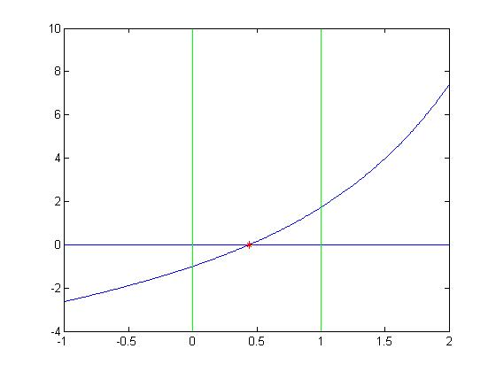
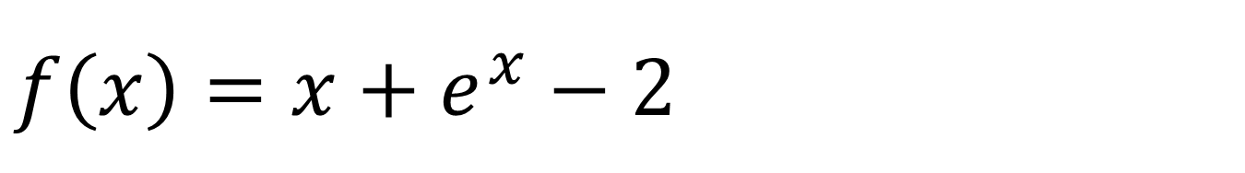
$f\left(x\right)=x+e^{x}−2$

Slide 19
Reference
[1] From Wikipedia: http://en.wikipedia.org/wiki/Descartes'_rule_of_signs

Slide 20
Questions?

Slide 21
Thank you!

